Slide 1

PET SHOP
Haridha.R.R
Haridha.rr@dedalus.eu

Slide 2
About Project
The objective of the Pet Shop is to design a simple and adaptable website for purchase and sale of pets which helps the customers decrease the commission fee paid to the agents.
And also users can adopt their favorite pets and what breed they want and can they choose their pet by color.
And users can select pet by their age also in whatever age they want.

Slide 3
Features implemented
JSON-Server-Auth
Nginx
Pipes
Form handling
Lazy loading of modules
Routing, Child routing and params HTTPClient and Observables
Angular Material Controls.

Slide 4
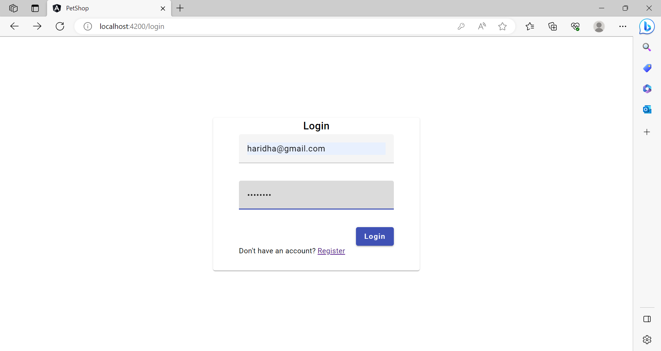
Login

